Slide 1
A special calendar
for you
Welcome December,
that special time of the year
is here….
by Valentina Tenedini
December 2020

Slide 2
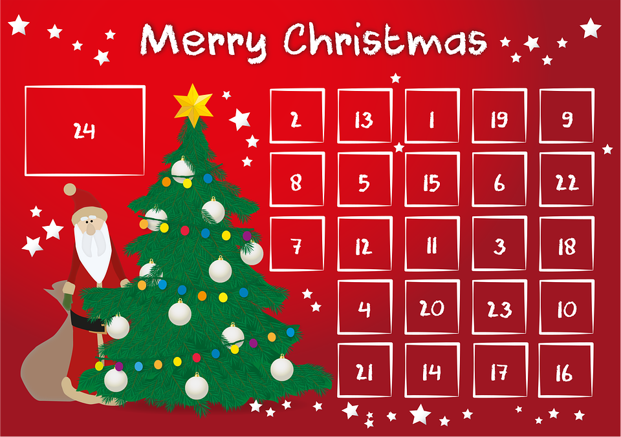
May the soothing power
of music
lift our spirits
and revive
our childhood, carefree
enthusiasm…
Have a very Merry Xmas!

Slide 3
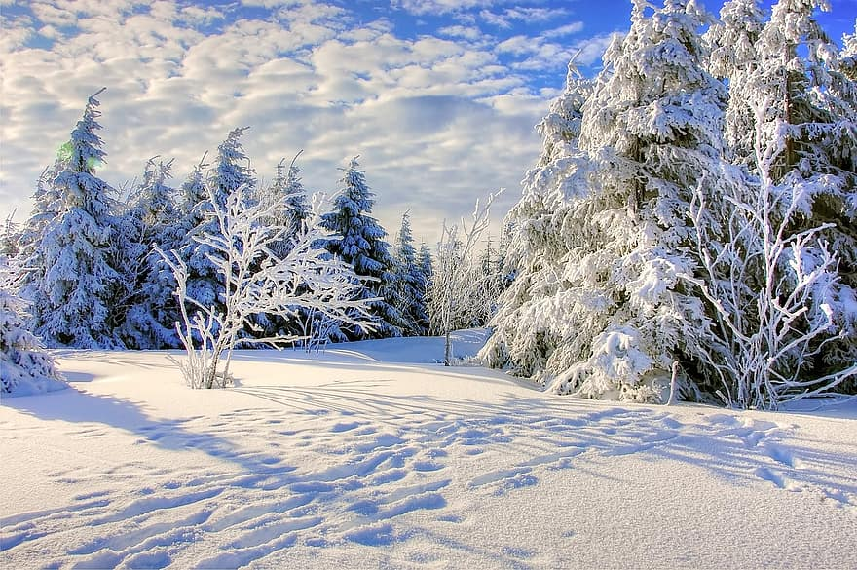
1 December
Winter wonderland
(listen and choose your favourite version)
https://www.youtube.com/watch?v=PA9GueR5rfc https://www.youtube.com/watch?v=Cs62MpaU5pY https://www.youtube.com/watch?v=GP5_dJUd3BY

Slide 4
2 December
December song
I dreamt of Christmas https://www.youtube.com/watch?v=l-xzyD00_fI

Slide 5
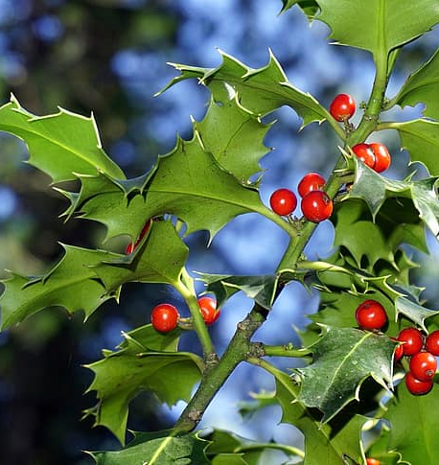
3 December
Deck the halls
https://www.youtube.com/watch?v=DCUynFZUFGY

Slide 6
4 December
Let it snow https://www.youtube.com/watch?v=Rnil5LyK_B0

Slide 7
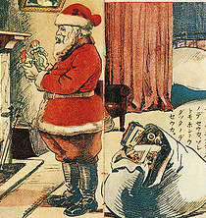
5 December
I believe in Father Christmas https://www.youtube.com/watch?v=rBpL_1eV2RE

Slide 8
6 December
What Christmas means to me https://www.youtube.com/watch?v=bg8fCyRbv_I

Slide 9
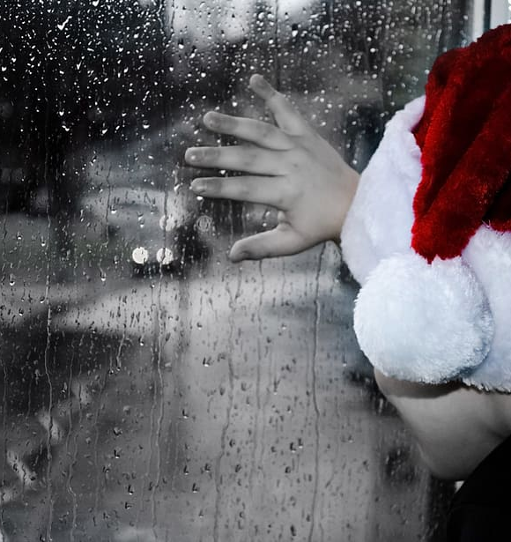
7 December
I wish it could be Christmas everyday https://www.youtube.com/watch?v=hh7jFGN1rwU

Slide 10
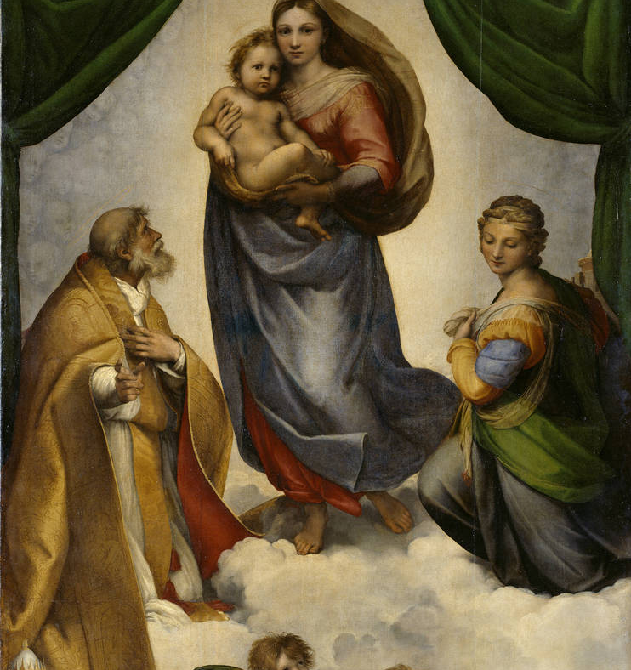
8 December
Mary's little child https://www.youtube.com/watch?v=cmm1gt_2SkQ

Slide 11
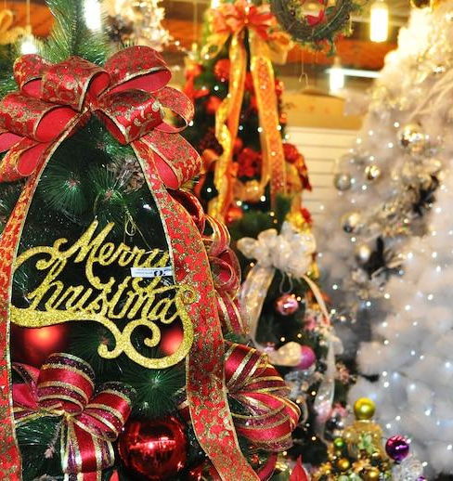
9 December
It's beginning to look a lot like Christmas https://www.youtube.com/watch?v=WaNwEkCeZrE

Slide 12
10 December
Christmas time https://www.youtube.com/watch?v=aV-eP8K6bhw

Slide 13
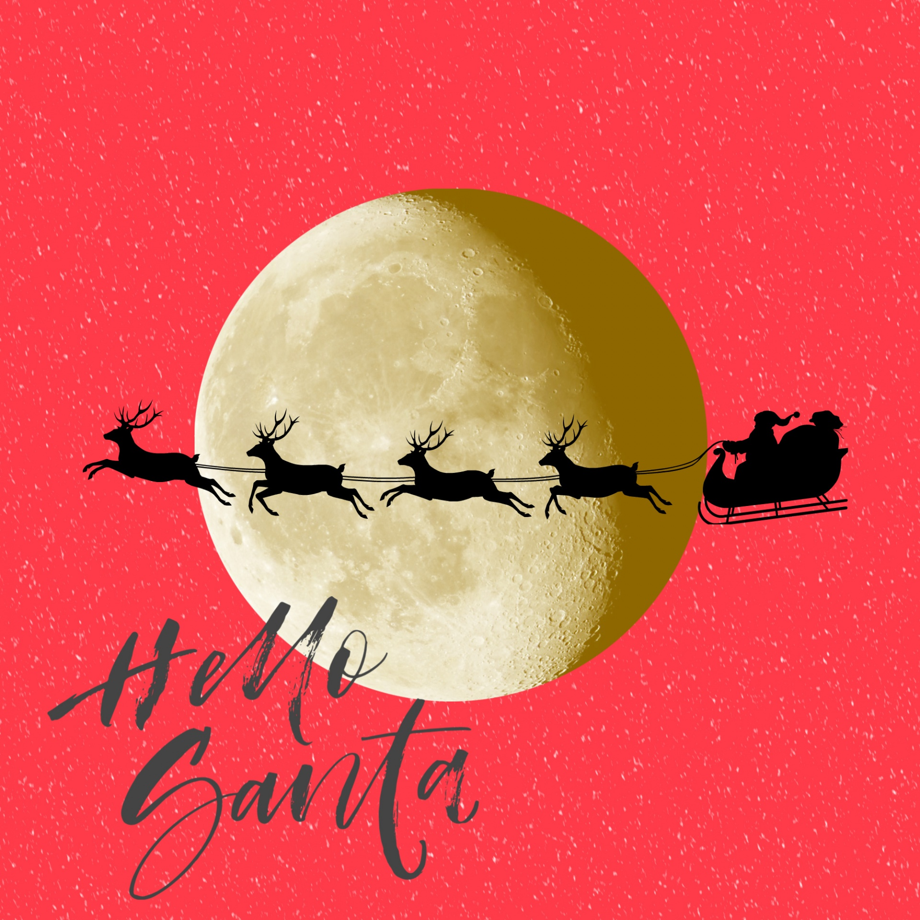
11 December
Run rudolph run https://www.youtube.com/watch?v=SqVtqbzTdVs

Slide 14
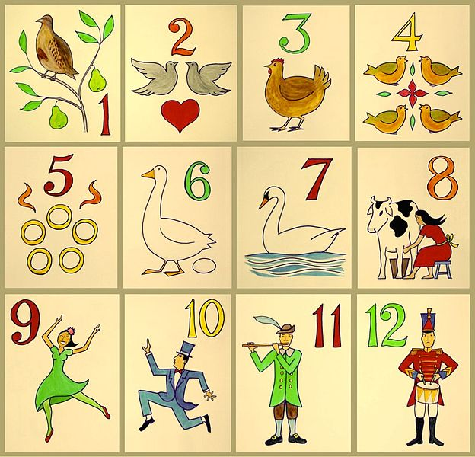
12 December
12 days of Christmas https://www.youtube.com/watch?v=qySAkZwLrOA

Slide 15
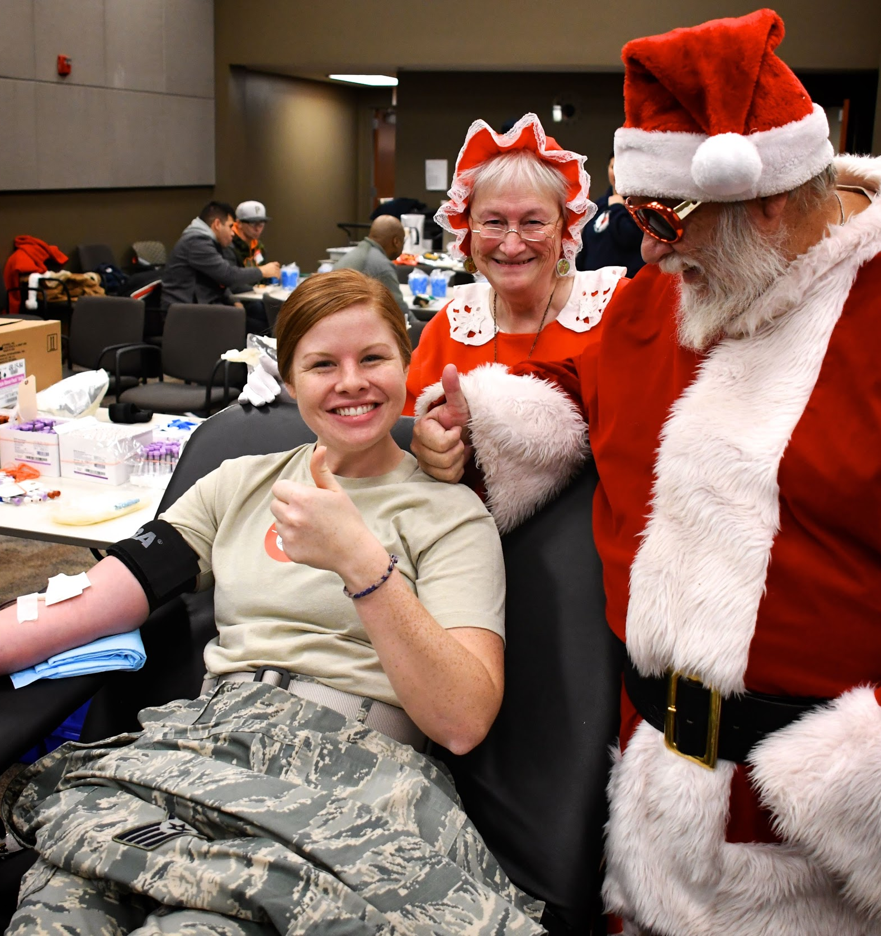
13 December
Do they know it’s Christmas choose your favourite version
https://www.youtube.com/watch?v=-w7jyVHocTk (2014) https://www.youtube.com/watch?v=bjQzJAKxTrE (1985)

Slide 16
14 December
White Christmas https://www.youtube.com/watch?v=FMyBJAZFiqI

Slide 17
15 December
Jingle bells https://www.youtube.com/watch?v=hLf0-lro8X8 https://www.youtube.com/watch?v=2tk9wuADoxA

Slide 18
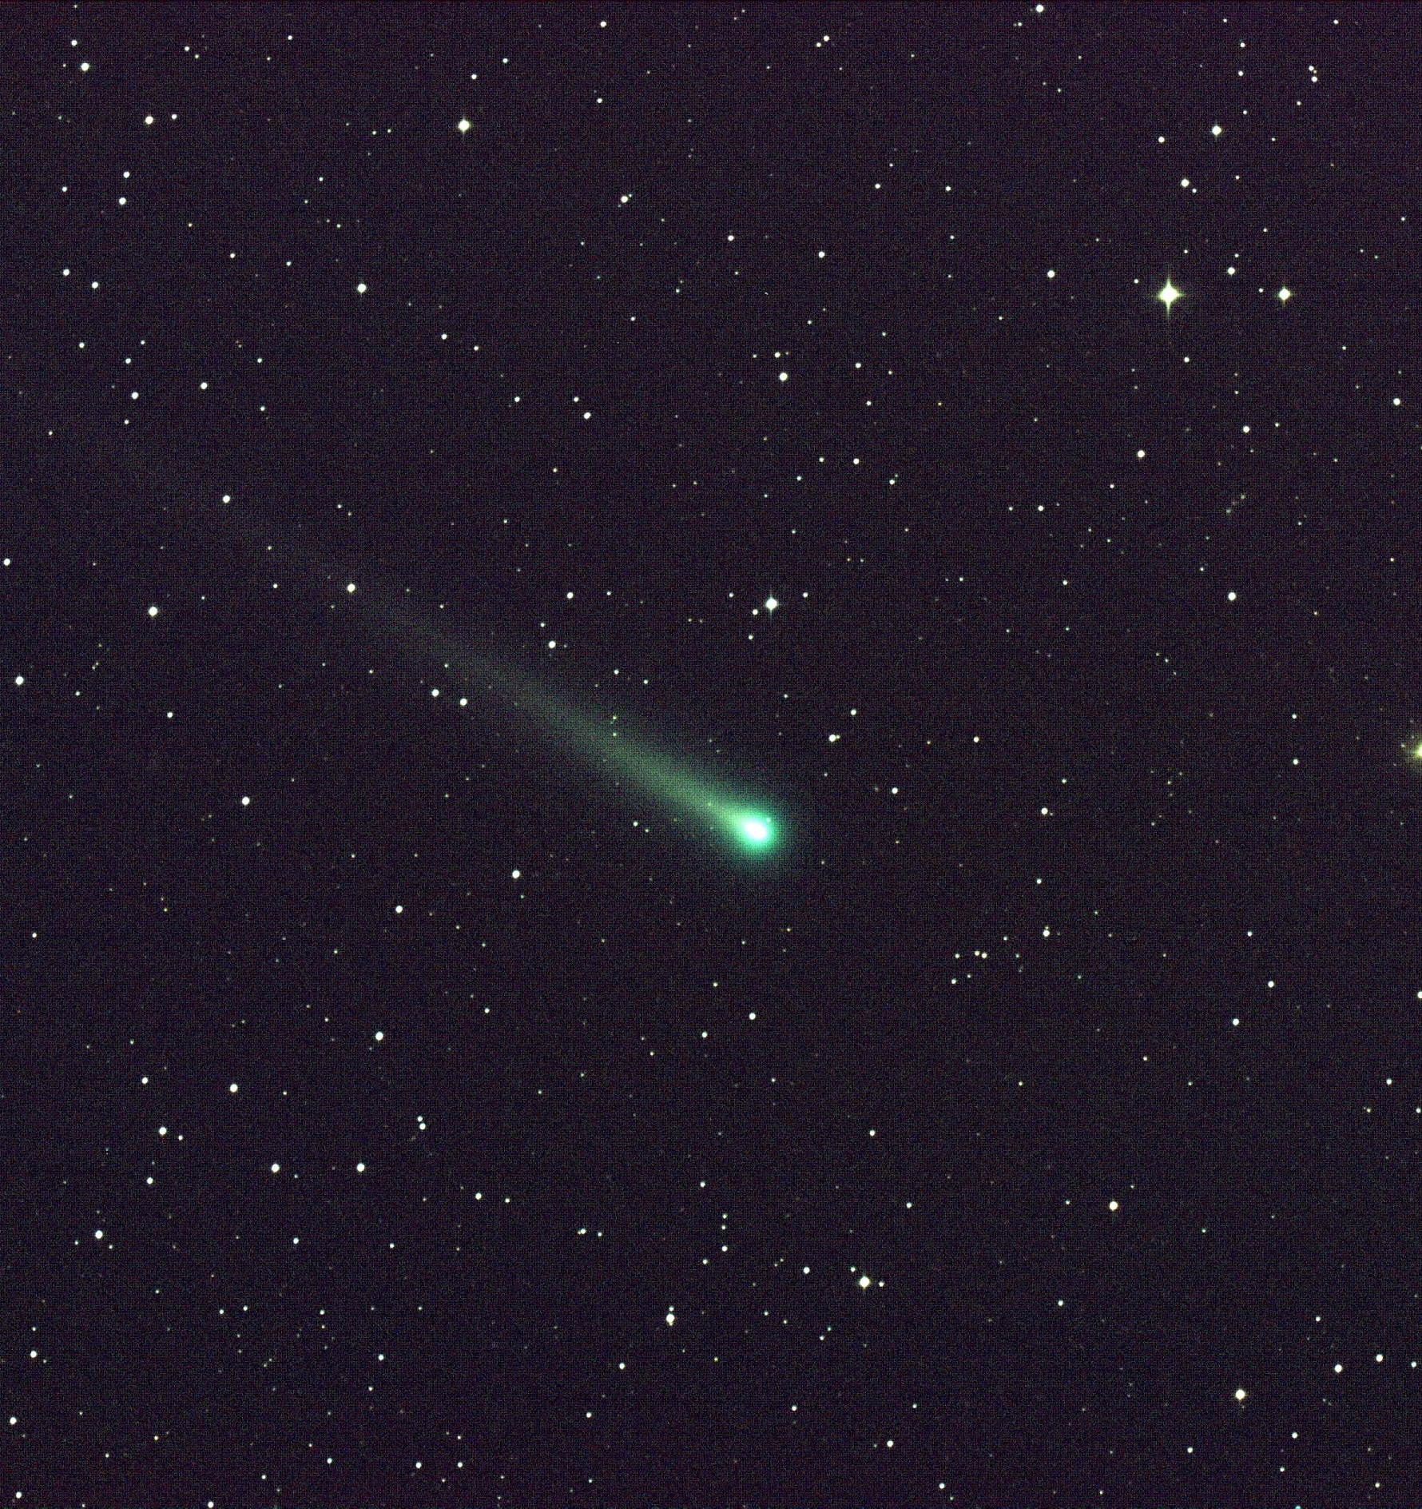
16 December
God rest you merry gentlemen https://www.youtube.com/watch?v=3b3WjMhtuNo

Slide 19
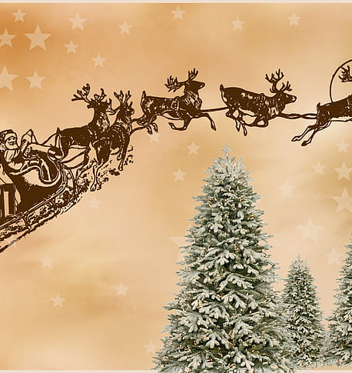
17 December
Santa Claus is coming to town
choose your favourite version https://www.youtube.com/watch?v=0DpCDxoj_Xg https://www.youtube.com/watch?v=SnA52s7qceM

Slide 20
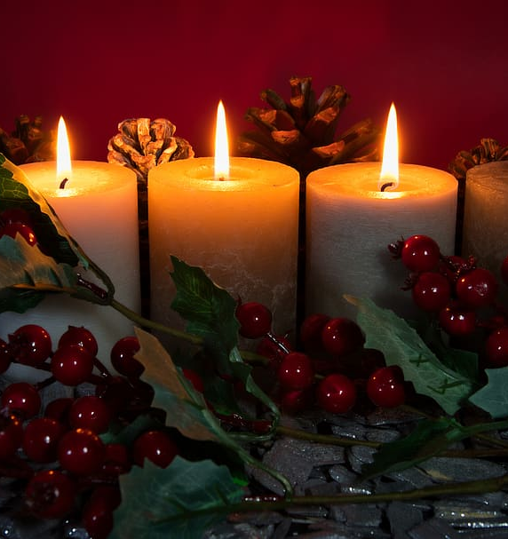
18 December
My favourite time of the year
https://www.youtube.com/watch?v=H10f2w7T5CU

Slide 21
19 December
Jingle bells rock https://www.youtube.com/watch?v=Jz9q3Bigqac

Slide 22
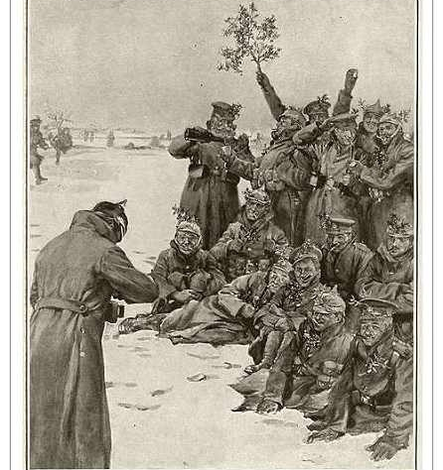
20 December
Happy xmas - war is over
https://www.youtube.com/watch?v=flA5ndOyZbI

Slide 23
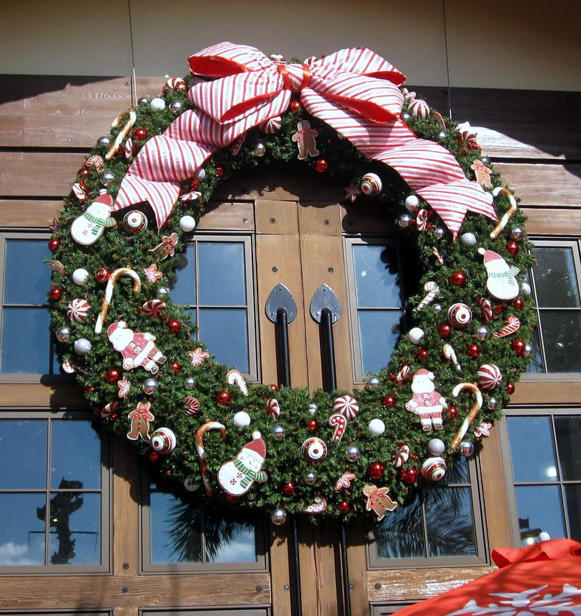
21 December
Last Christmas https://www.youtube.com/watch?v=E8gmARGvPlI

Slide 24
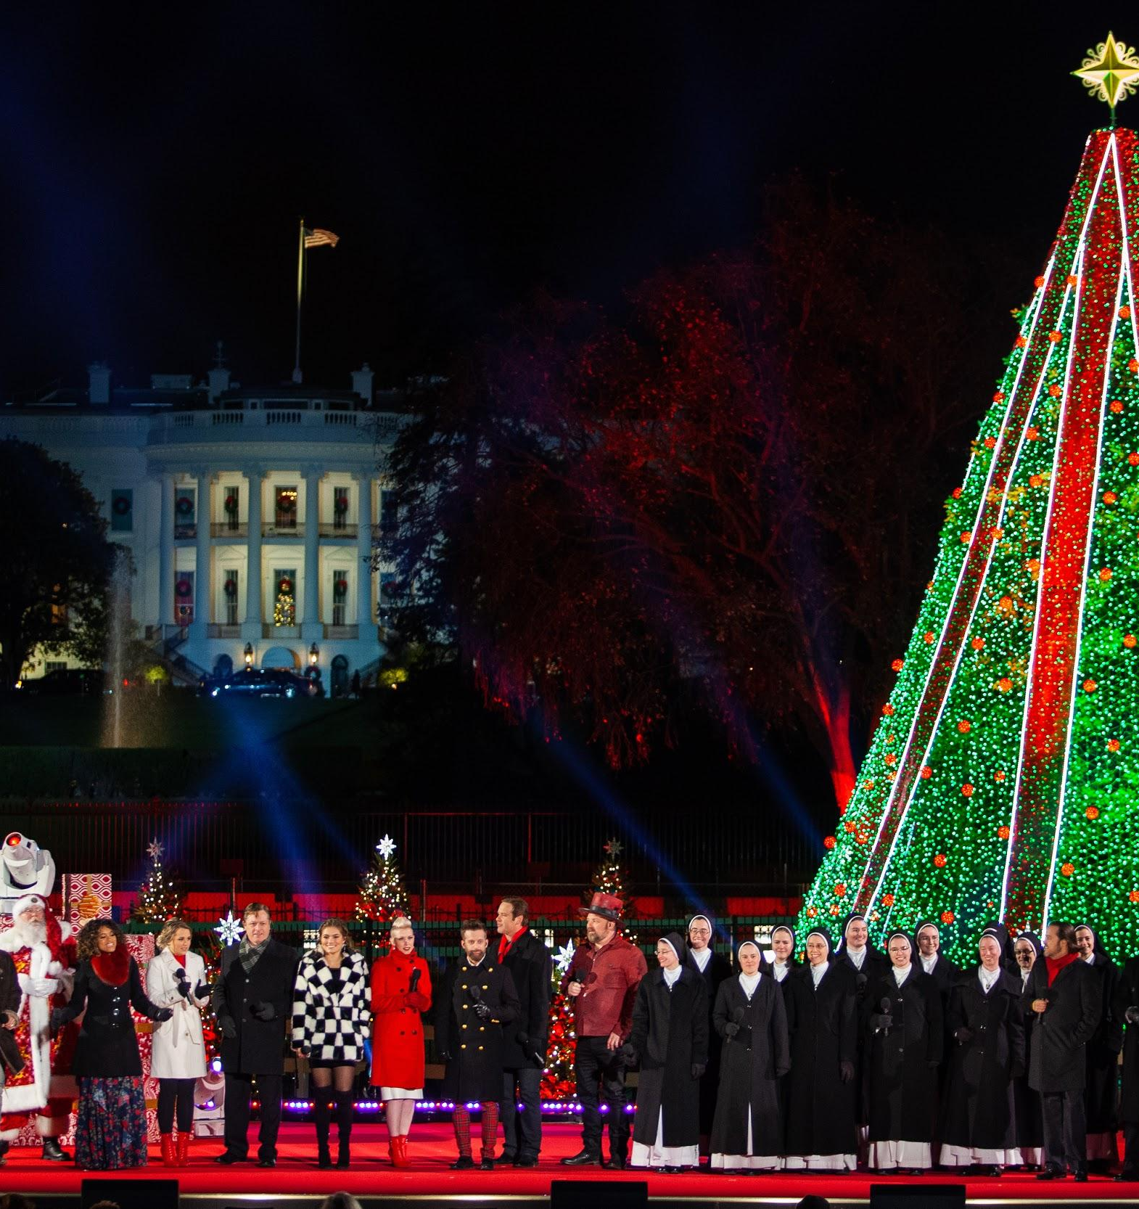
22 December
Thank God it's Christmas https://www.youtube.com/watch?v=qw2TD91Nytg

Slide 25
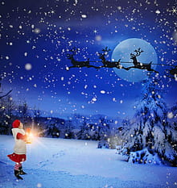
23 December
Can't stop Christmas https://www.youtube.com/watch?v=BW4nXP9N7Fg

Slide 26
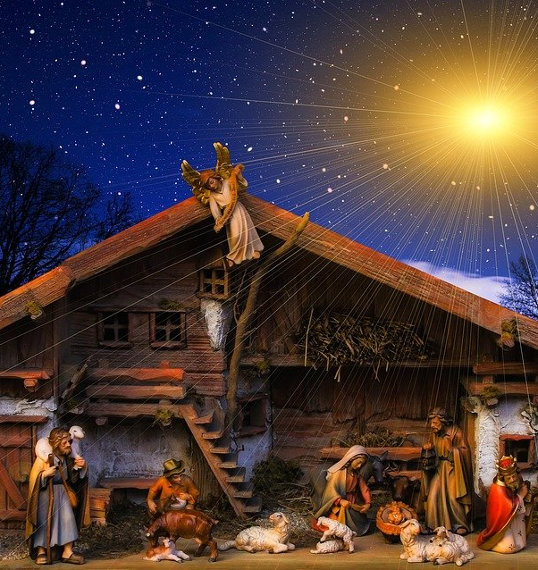
24 December
Silent Night https://www.youtube.com/watch?v=UNpiQwgStNA https://www.youtube.com/watch?v=0RpMnk8PkVA

Slide 27
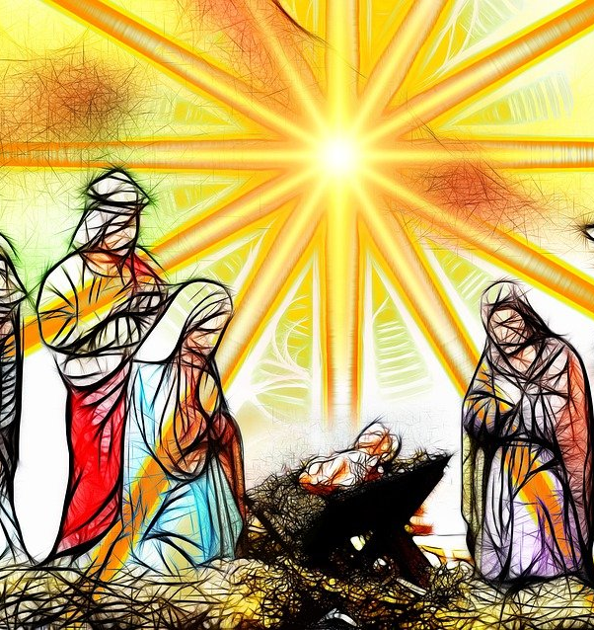
25 December
The first noel https://www.youtube.com/watch?v=mawwURNqPC0
Joy to the world https://www.youtube.com/watch?v=MpgaWm2pnNs

Slide 28
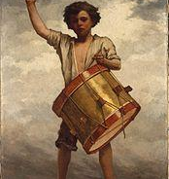
26 December
The little drummer boy
https://www.youtube.com/watch?v=3sKmHiGOv70

Slide 29
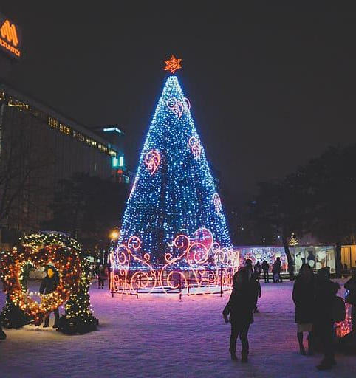
27 December
Rocking around the Christmas tree
https://www.youtube.com/watch?v=1qYz7rfgLWE

Slide 30
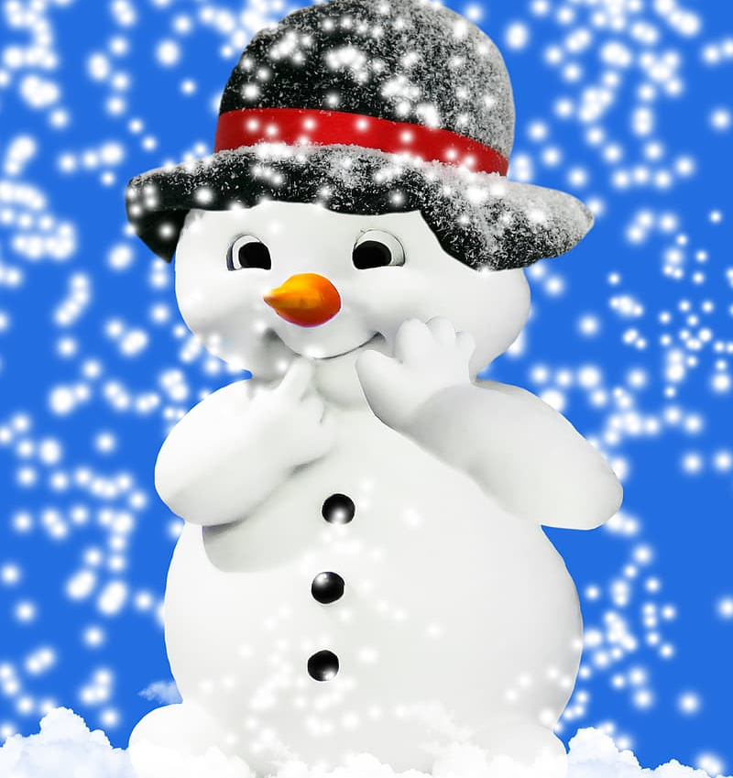
28 December
Frosty the melting snowman
https://www.youtube.com/watch?v=k6zW225k_O0

Slide 31
29 December
Snowflakes
https://www.youtube.com/watch?v=htKhqR6KH3Q

Slide 32
30 December
Oh Happy Day
https://www.youtube.com/watch?v=olQrCfkvbGw

Slide 33
31 December
Auld lang syne https://www.youtube.com/watch?v=3BABABX5T2E
With my very best wishes,
may all your hopes
& dreams come true !

